Slide 1



Understanding Hashing and Implementing Hash Table with Separate Chaining

Slide 2



Introduction
Hashing Explained
Hash Table with Separate Chaining
Implementation Steps
Advantages of Hash Table with Separate Chaining
Example
Summary
Contents

Slide 3


Introduction

Slide 4


Introduction
Hashing is a technique used in computer science to efficiently store and retrieve data in a data structure called a hash table.
It provides constant-time average-case complexity for search, insert, and delete operations.
One standard method of handling collisions in hash tables is separate chaining, where each bucket in the hash table contains a linked list of elements.

Slide 5


What is Hashing?

Slide 6


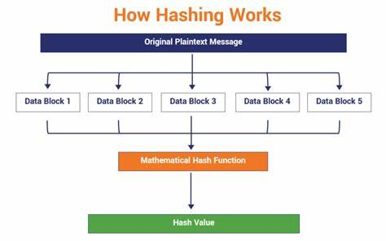

What is Hashing?
Hashing is the process of mapping data of arbitrary size to fixed-size values (hash codes) using a hash function.

Slide 7
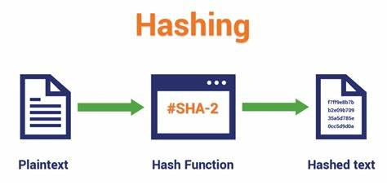
What is Hashing?
The hash function takes an input (data) and computes a unique hash code.

Slide 8
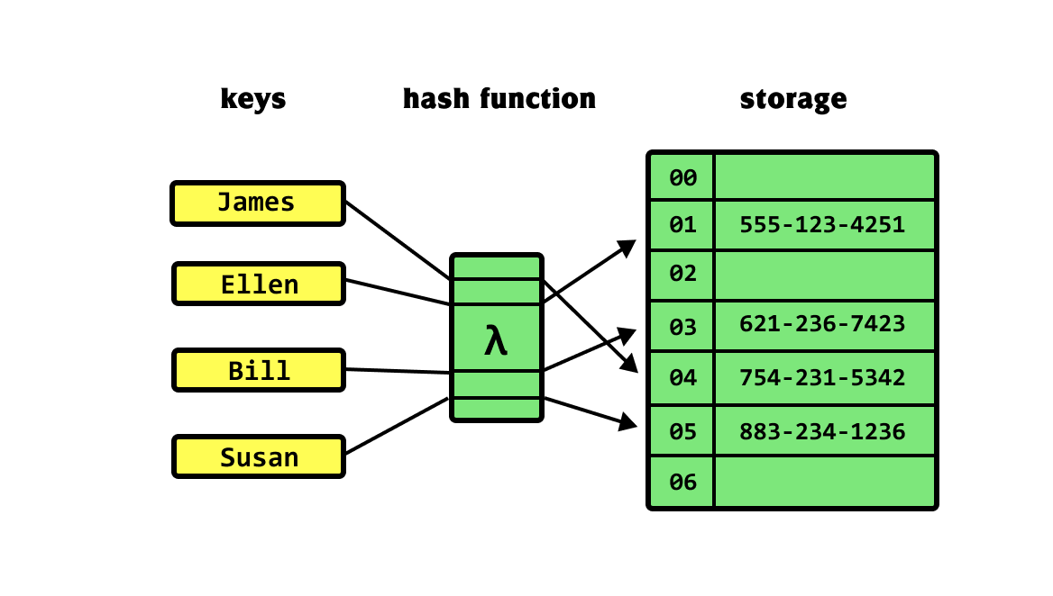
What is Hashing?
The hash code is used as an index to store and retrieve data in the hash table.

Slide 9
Hash Table with Separate Chaining

Slide 10
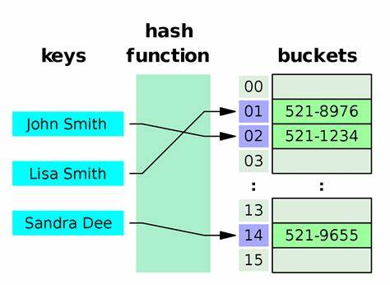
Hash Table with Separate Chaining
A hash table is an array-based data structure that uses hashing to store and retrieve elements.

Slide 11
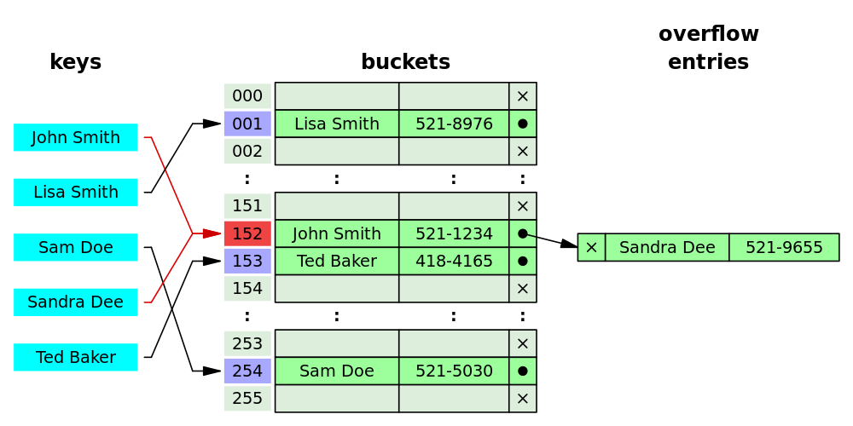
Hash Table with Separate Chaining
Separate chaining is a collision resolution technique where each bucket in the hash table contains a linked list.
When a collision occurs (two elements hash to the same index), the new element is appended to the linked list at that index.

Slide 12



Implementation Steps

Slide 13

Implementation Steps
Design the hash table with an array and a linked list structure.
Define a hash function that converts the data into a hash code.
Create a method to insert an element into the hash table.
Handle collisions by appending elements to the linked list at the corresponding index.
Implement a method to search for an element by its key.
Implement a method to delete an element from the hash table.

Slide 14
Advantages of Hash Table with Separate Chaining

Slide 15
Advantages of Hash Table with Separate Chaining
EFFICIENT HANDLING OF COLLISIONS
Separate chaining addresses the issue of collisions that can occur when multiple elements are mapped to the same index in a hash table.
Instead of overwriting the existing value, multiple elements can be stored at the same index by forming a linked list or other data structure. This reduces collisions and allows for efficient storage and retrieval of elements.

Slide 16
Advantages of Hash Table with Separate Chaining
SIMPLE IMPLEMENTATION
DYNAMIC RESIZING
Separate chaining is relatively easy to implement compared to other collision resolution techniques.
The hash table can dynamically resize itself to maintain performance as the number of elements grows.

Slide 17
Example

Slide 18
Example
Consider implementing a hash table with separate chaining to store student records by their ID.
Hash function: Compute the hash code by taking the modulus of the ID with the size of the hash table.
Collisions: If multiple students have the same hash code, store them in a linked list at the corresponding index.

Slide 19
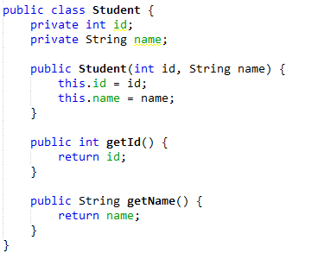
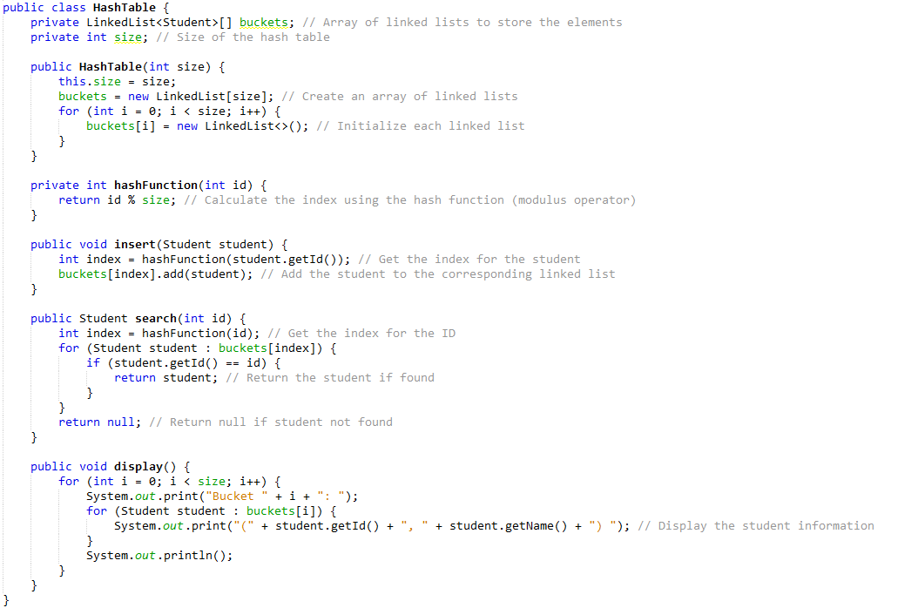

Slide 20
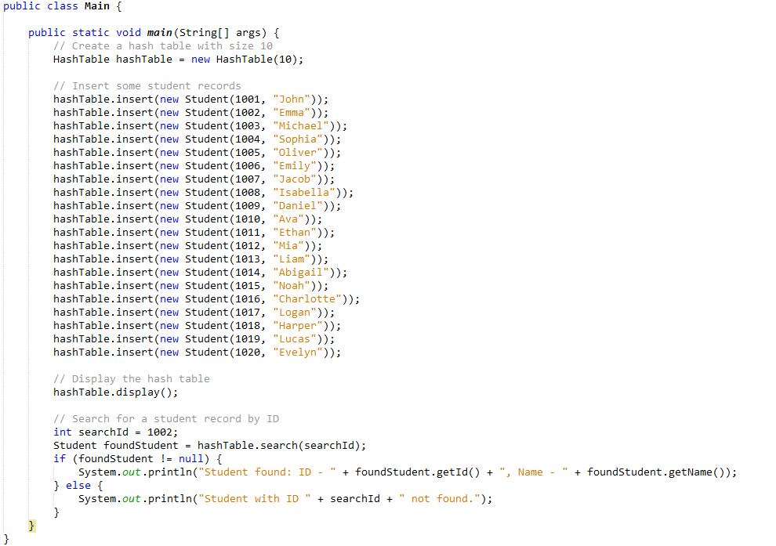
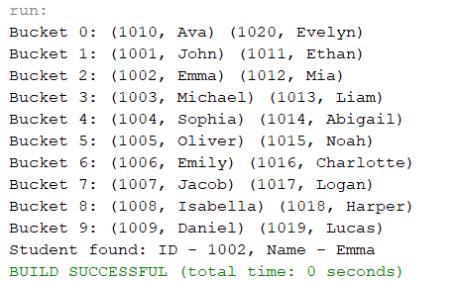

Slide 21
Summary

Slide 22
Hashing is a technique for efficiently storing and retrieving data in a hash table.
Separate chaining is a collision resolution method in hash tables where each bucket contains a linked list.
Implementing a hash table with separate chaining involves designing the data structure, defining a hash function, and handling collisions.
Summary

Slide 23

Thank you!

